Slide 1

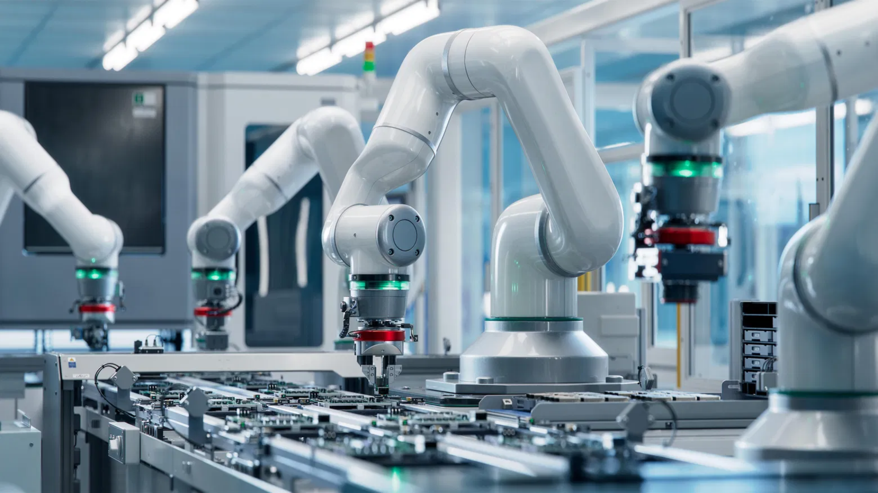
Robotics App Store Platform
Streamlined Hardware & Software Integration
A comprehensive solution for onboarding, configuring, and deploying robotics applications

Slide 2

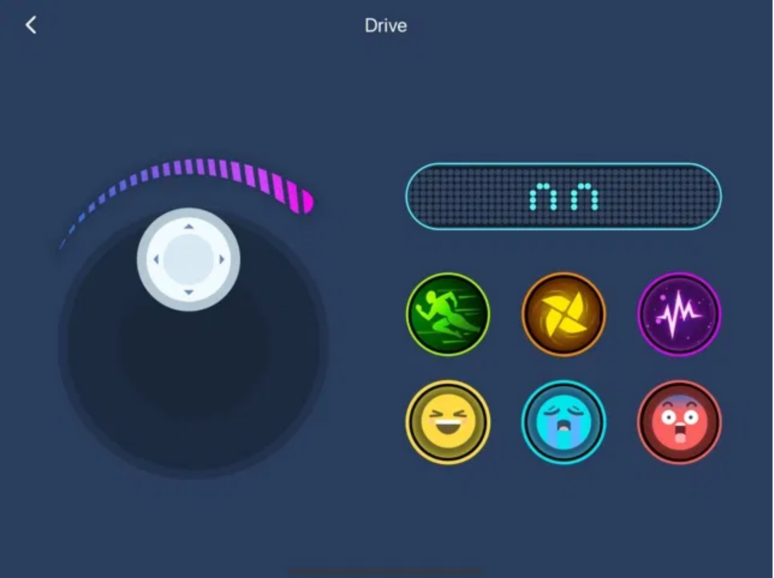
Platform Overview
What is the Robotics App Store?
A centralized platform for onboarding, distributing, and managing:
Hardware components
Software skills
Integrated bundles (hardware + skills)
Value Proposition
Standardized onboarding process
Simplified workcell configuration
Target Users & Roles
Reusable components and skills
Automated orchestration and deployment
Service Provider (SP)
Onboards new hardware and software skills from Git repositories
System Integrator (SI)
Creates agents using onboarded components and builds functional workcells
System Operator
Runs and monitors workcell pipelines in production environments

Slide 3

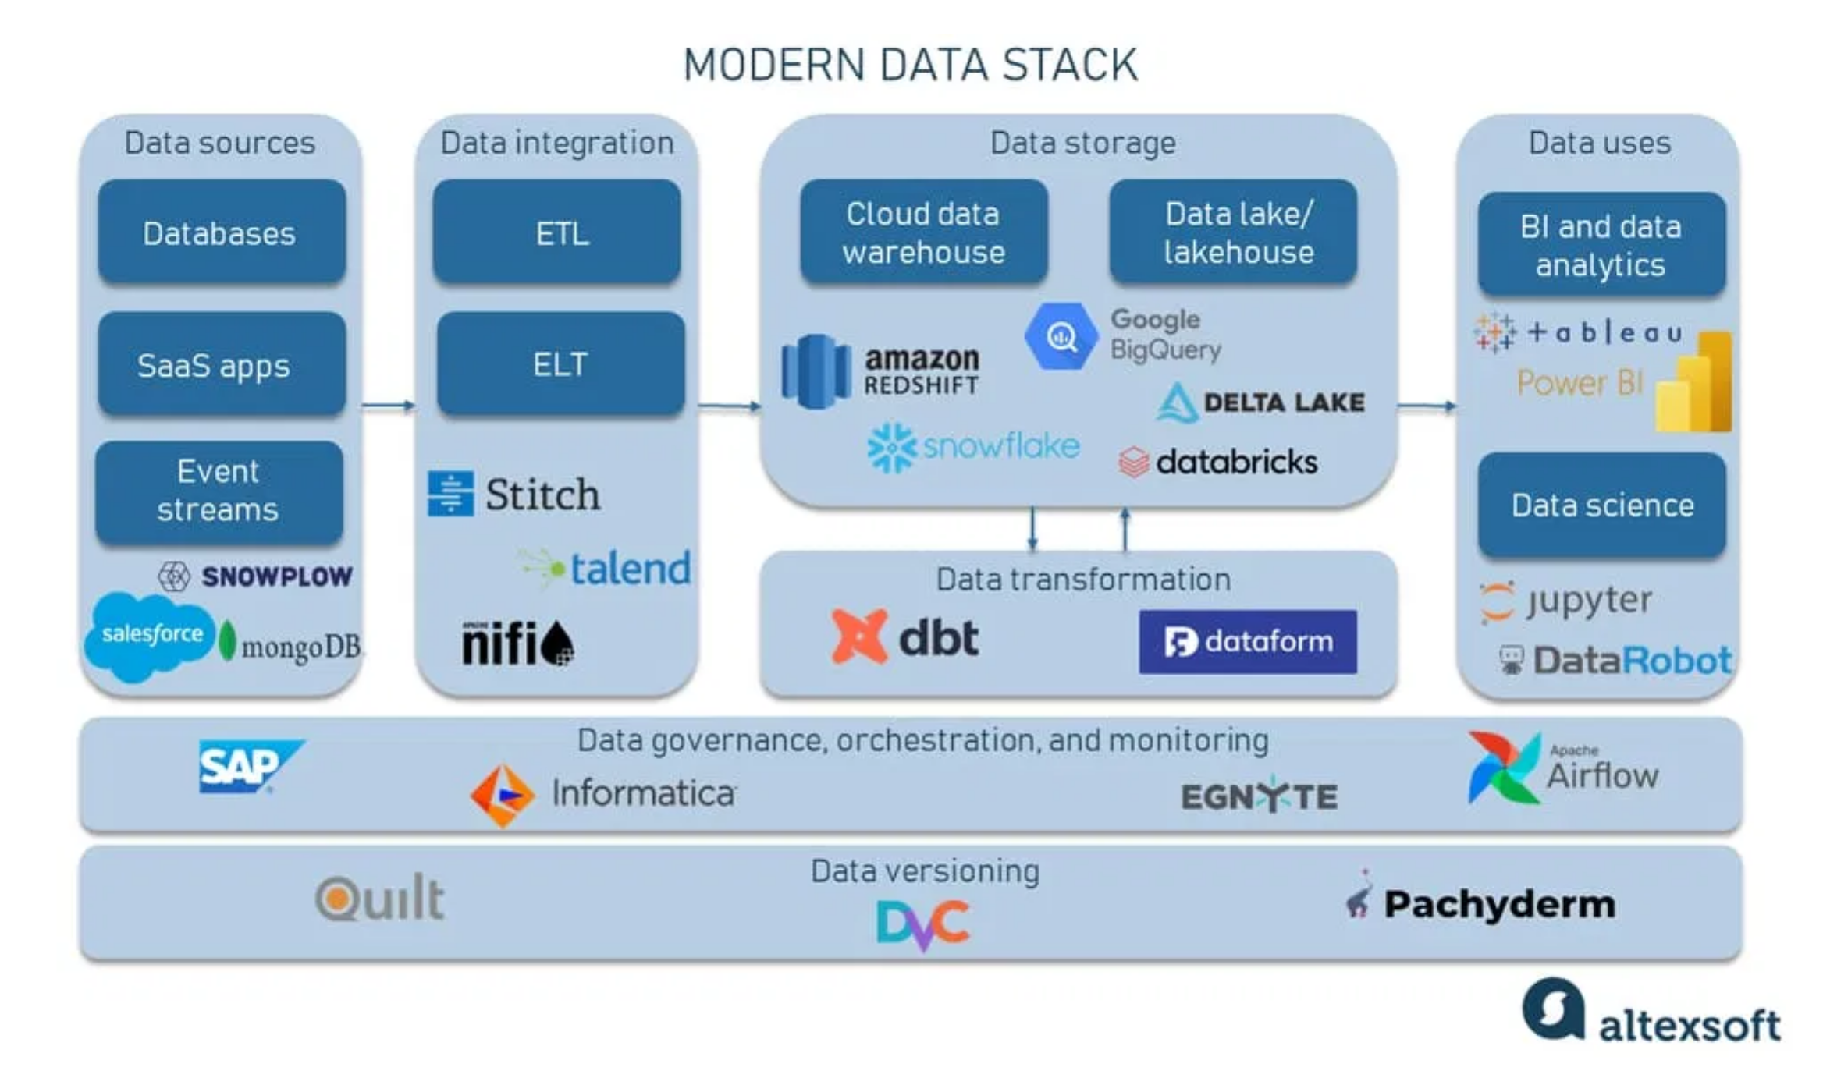





Technical Architecture
Automation & Orchestration
Semaphore
: CI/CD pipeline management
Ansible
: Configuration management and deployment
Database
PostgreSQL
: Persistent storage for:
Component metadata
Workcell configurations
Inventory information
Pipeline execution history
Caching & Queue
Backend
Redis
: High-performance caching and message queue for:
Spring Boot (Java)
: Core business logic, API endpoints
Real-time status updates
FastAPI (Python)
: ML processing, hardware interfaces
Task scheduling
Inter-service communication
Frontend
React
: Interactive UI for workcell design and monitoring

Slide 4

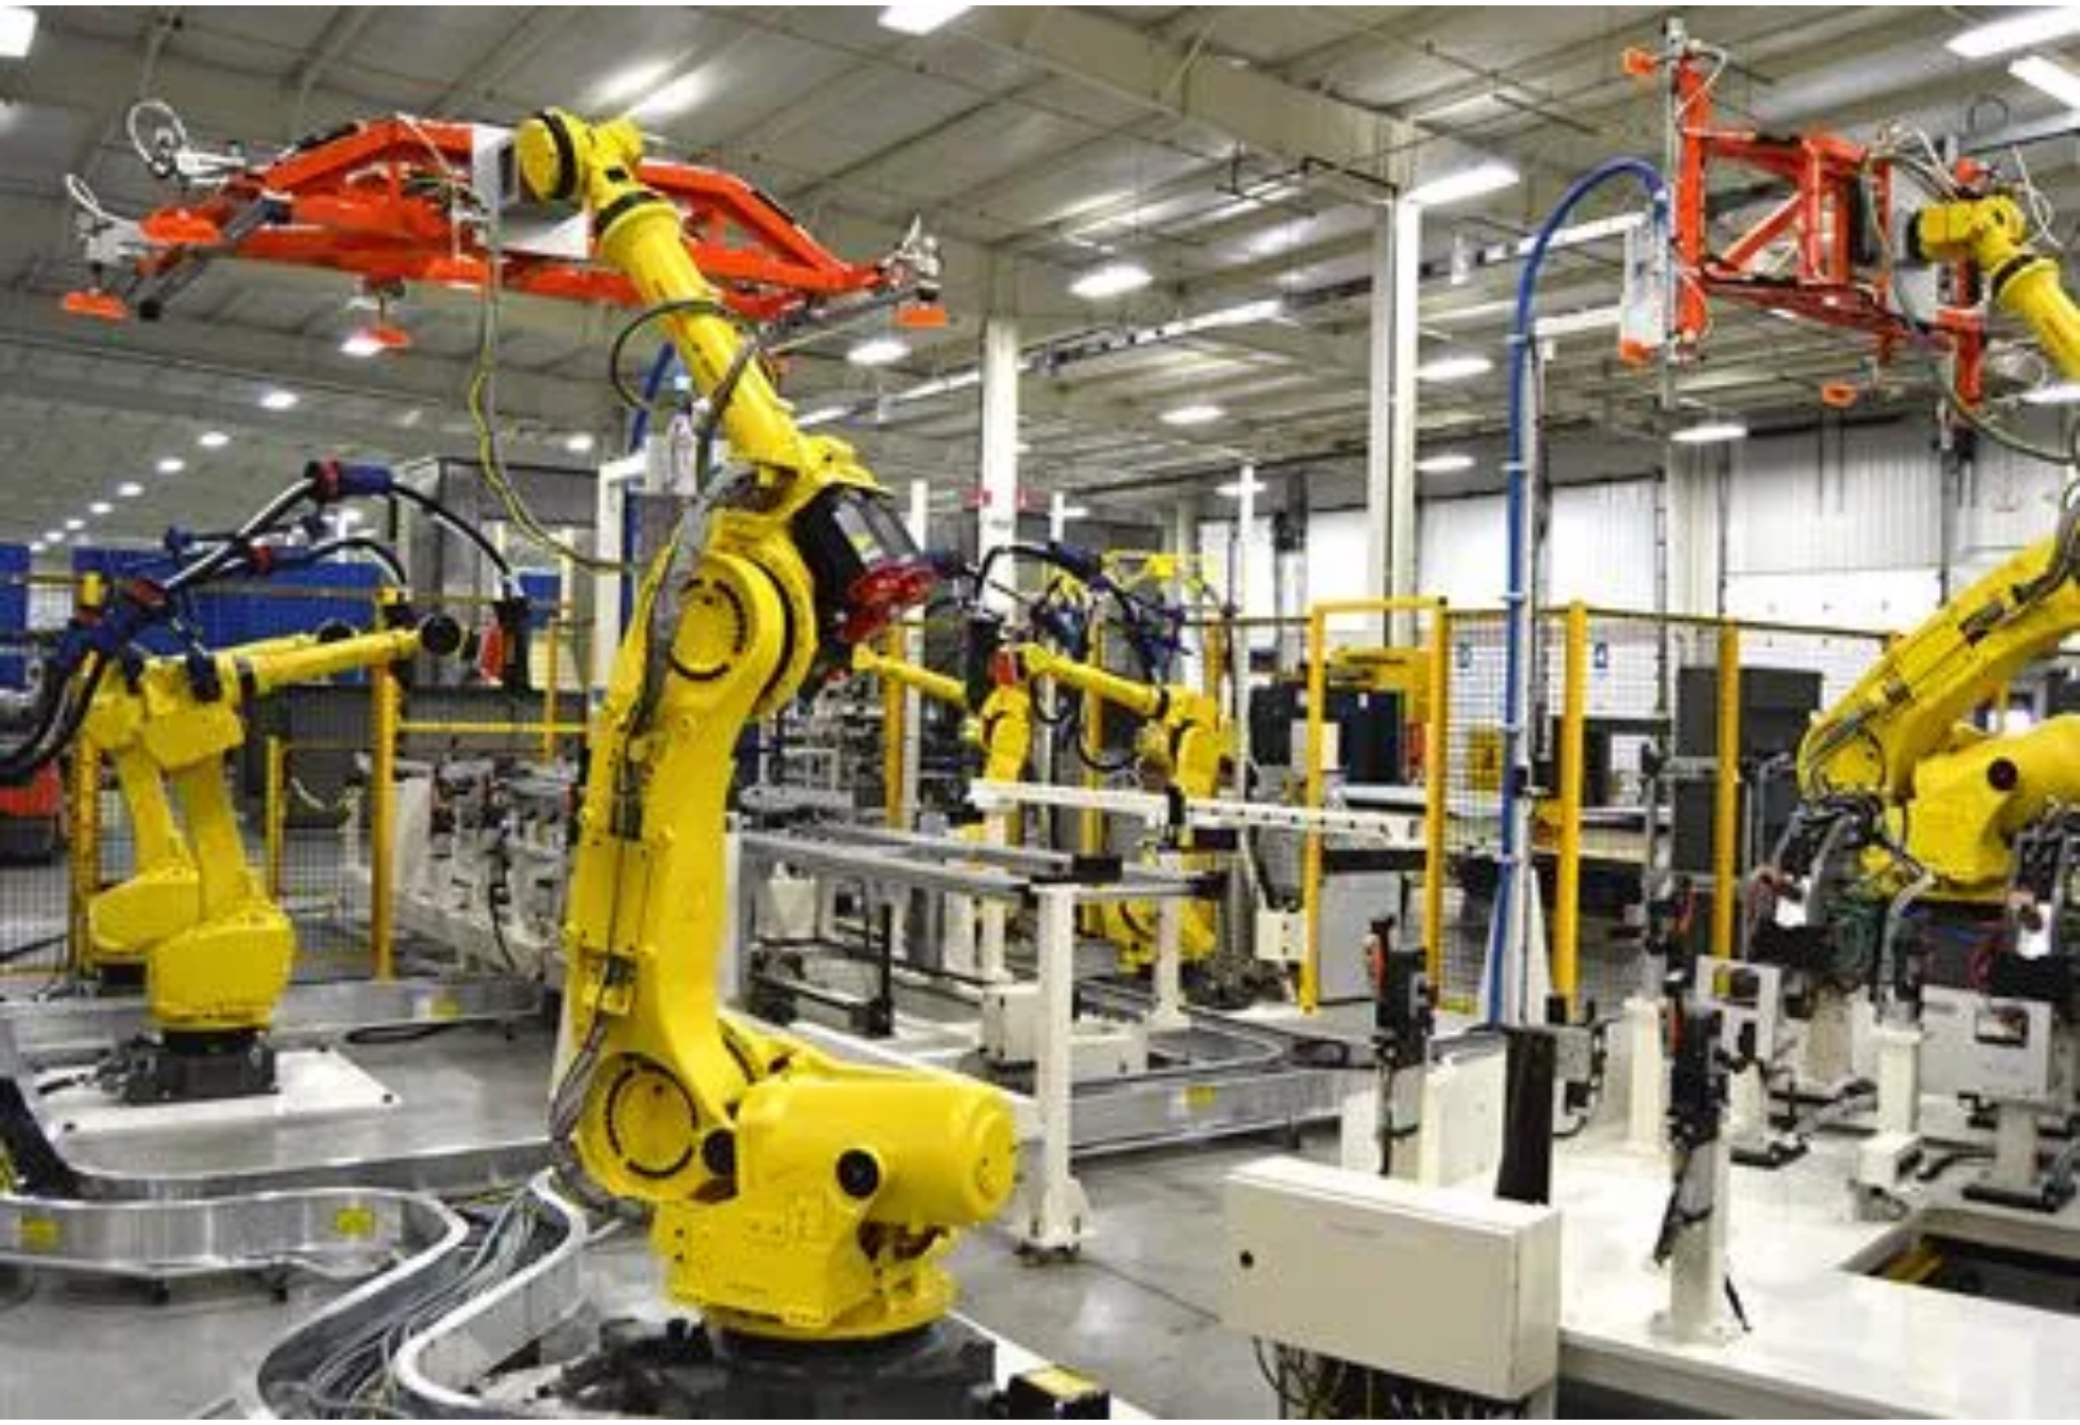



Onboarding Components
The Robotics App Store platform supports three main types of components that can be onboarded and utilized in workcell configurations:
Hardware Components
Physical robotic devices and peripherals
Sensors and actuators
Controllers and computing units
Specialized end-effectors and tools
Software Skills
Motion planning algorithms
Computer vision capabilities
Process control logic
Machine learning models
Component Onboarding Benefits
Bundles (Hardware + Skills)
Standardized interfaces and documentation
Version control and dependency management
Pre-configured combinations of hardware and software
Simplified discovery and integration
Ready-to-deploy functional units
Reusability across multiple workcells
Optimized for specific industrial applications
Tested and validated integrations

Slide 5

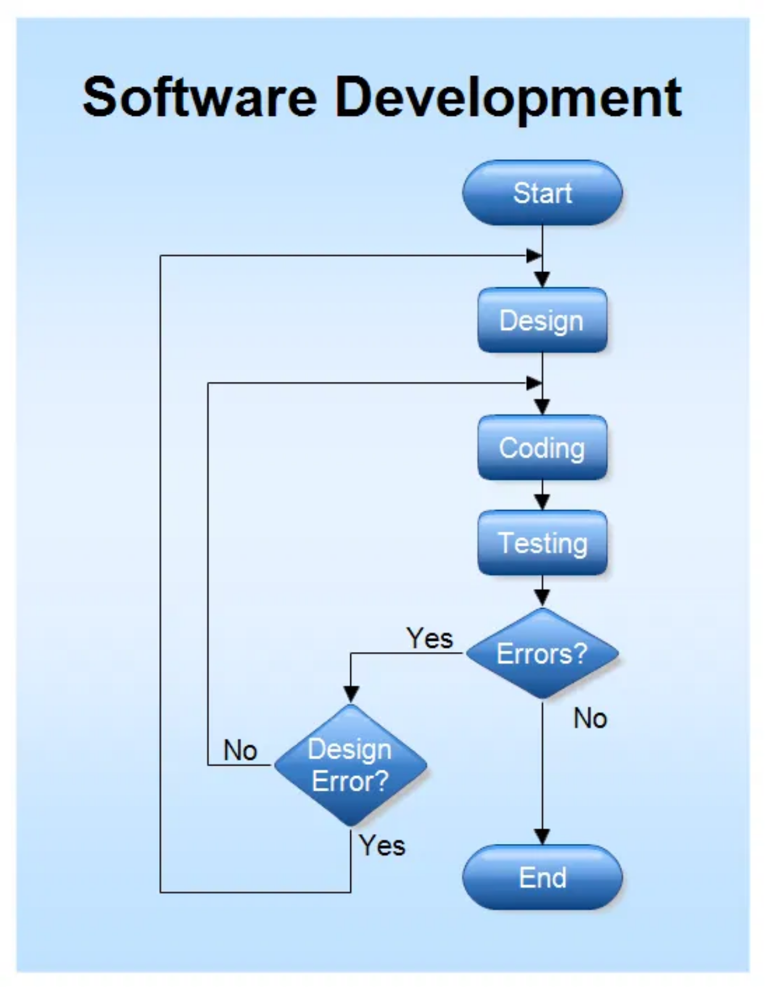




Onboarding Process Flow
Service Provider (SP) Role
The Service Provider is the
only role authorized
to onboard
new components to the platform.
1
Pull from Git Repository
SP pulls hardware/skills from a Git repository containing all required configuration files.
2
Validate Required Files
Each component folder must contain:
docker/ directory or script file
metadata.json with component specifications
Environment configuration for SP
hardware-component/
docker/
Dockerfile
3
Onboarding Process
docker-compose.yml
metadata.json
Platform validates files, registers component in database, and creates container images if needed.
environment.config
4
Repository Creation
Upon successful onboarding, a new repository is created in Semaphore for orchestration.

Slide 6

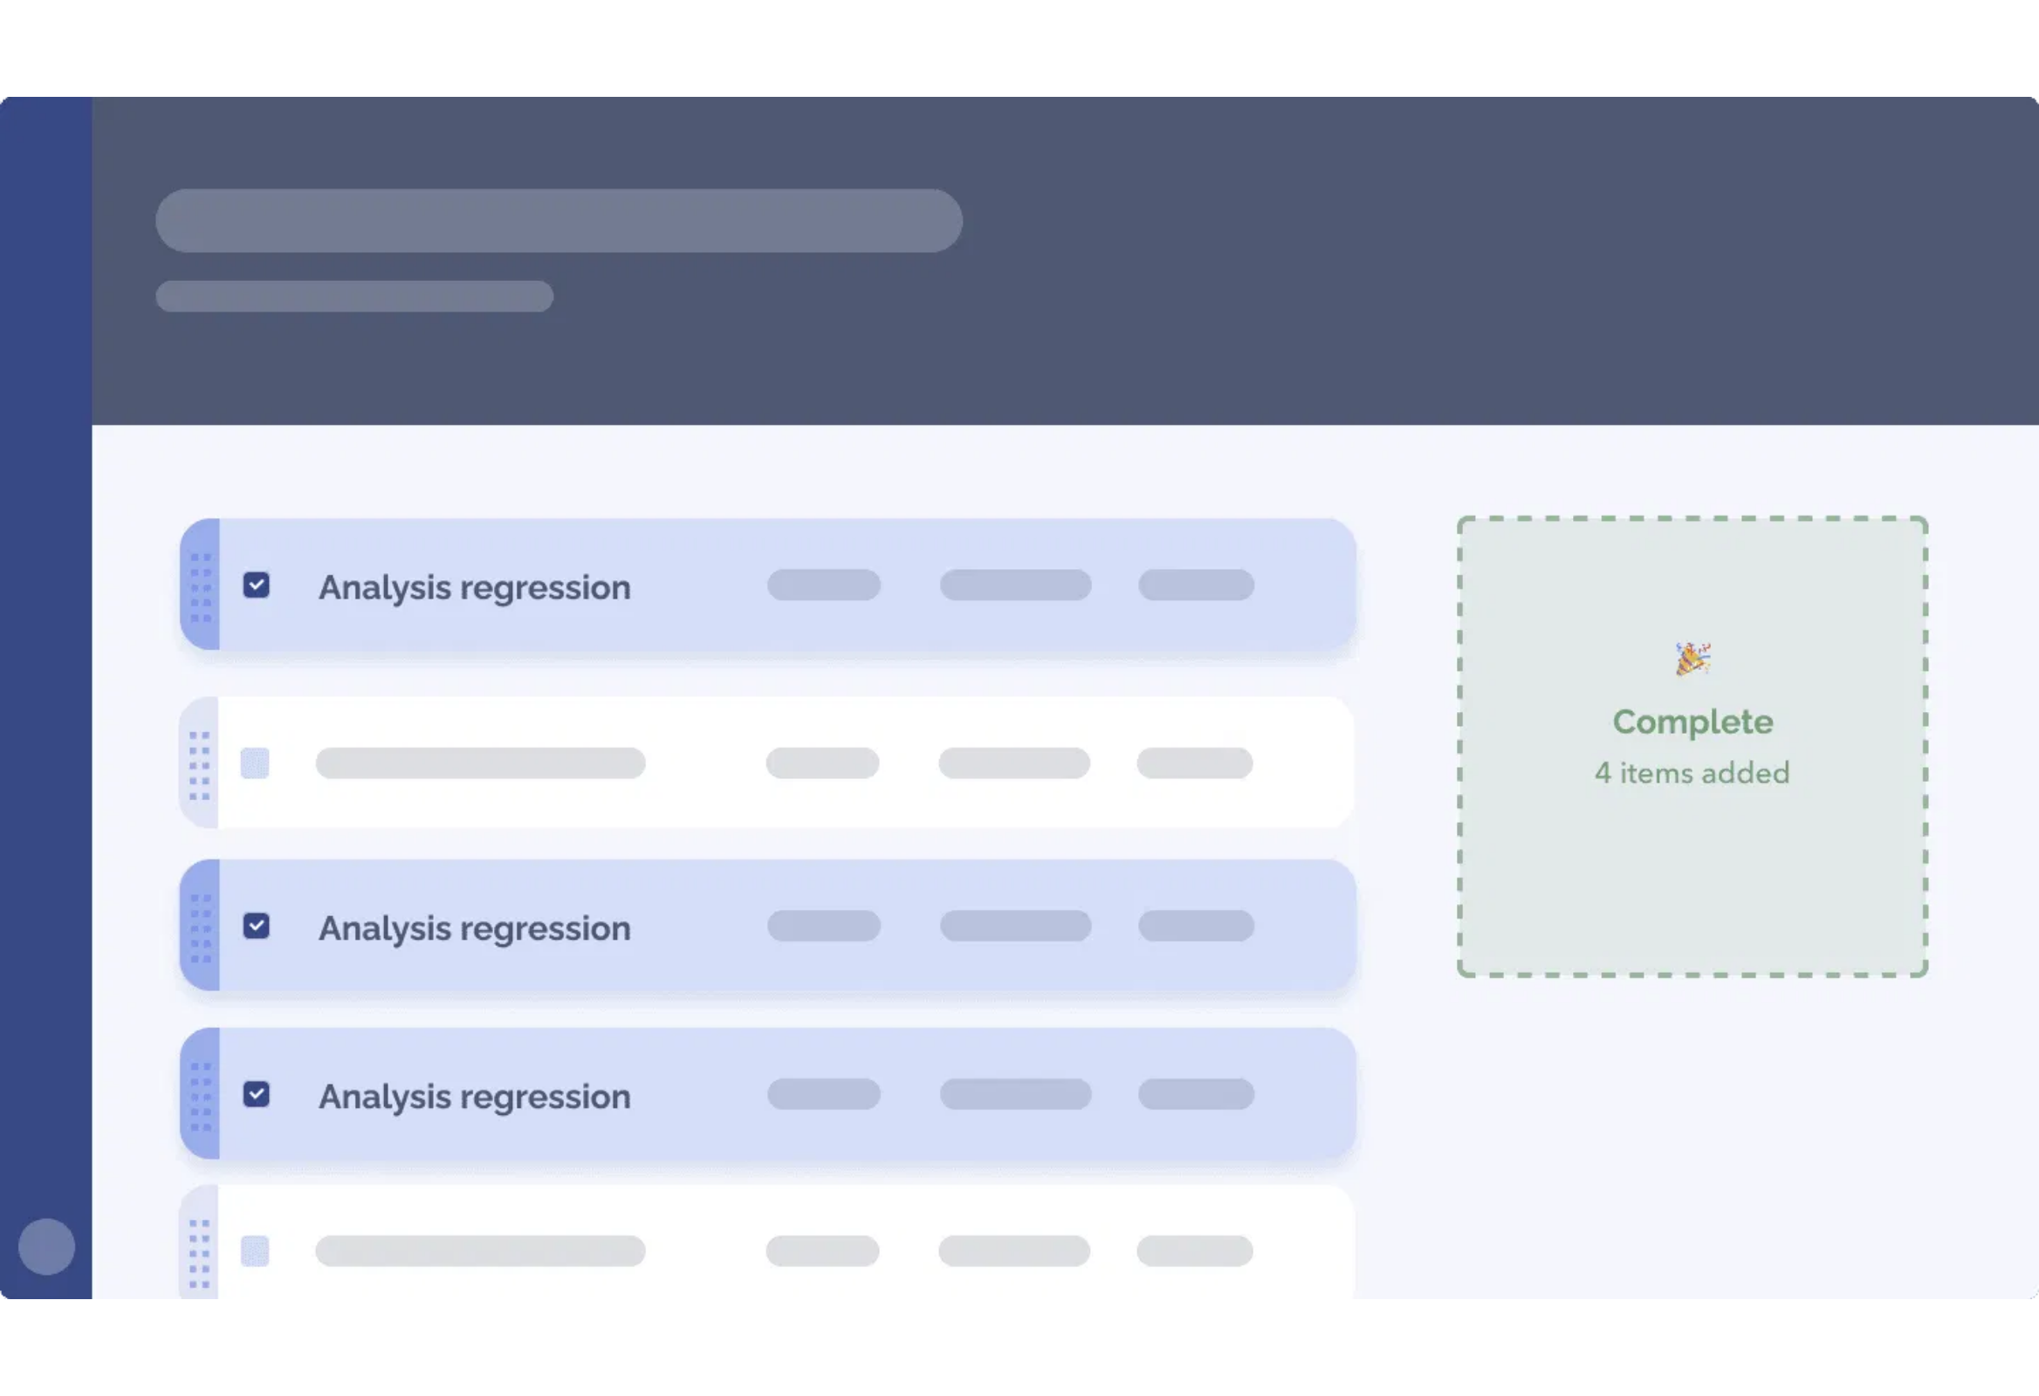

Workcell Setup Interface
Building Workcells
The Workcell tab in the React UI provides a visual environment for configuring automation systems:
1
Drag & Drop Hardware
Onboarded hardware components appear in the left panel and can be dragged onto the canvas to build a complete workcell.
2
Configure Properties
Each hardware component can be configured with specific properties (IP address, port, etc.) as allowed by the Service Provider.
3
Host System Integration
The intuitive drag & drop interface enables rapid workcell
configuration without requiring programming knowledge.
A host system is automatically added to each workcell to manage communication and coordination between components.
4
Inventory Generation
When a workcell is created, an inventory is automatically generated in Semaphore and stored in PostgreSQL for orchestration.

Slide 7

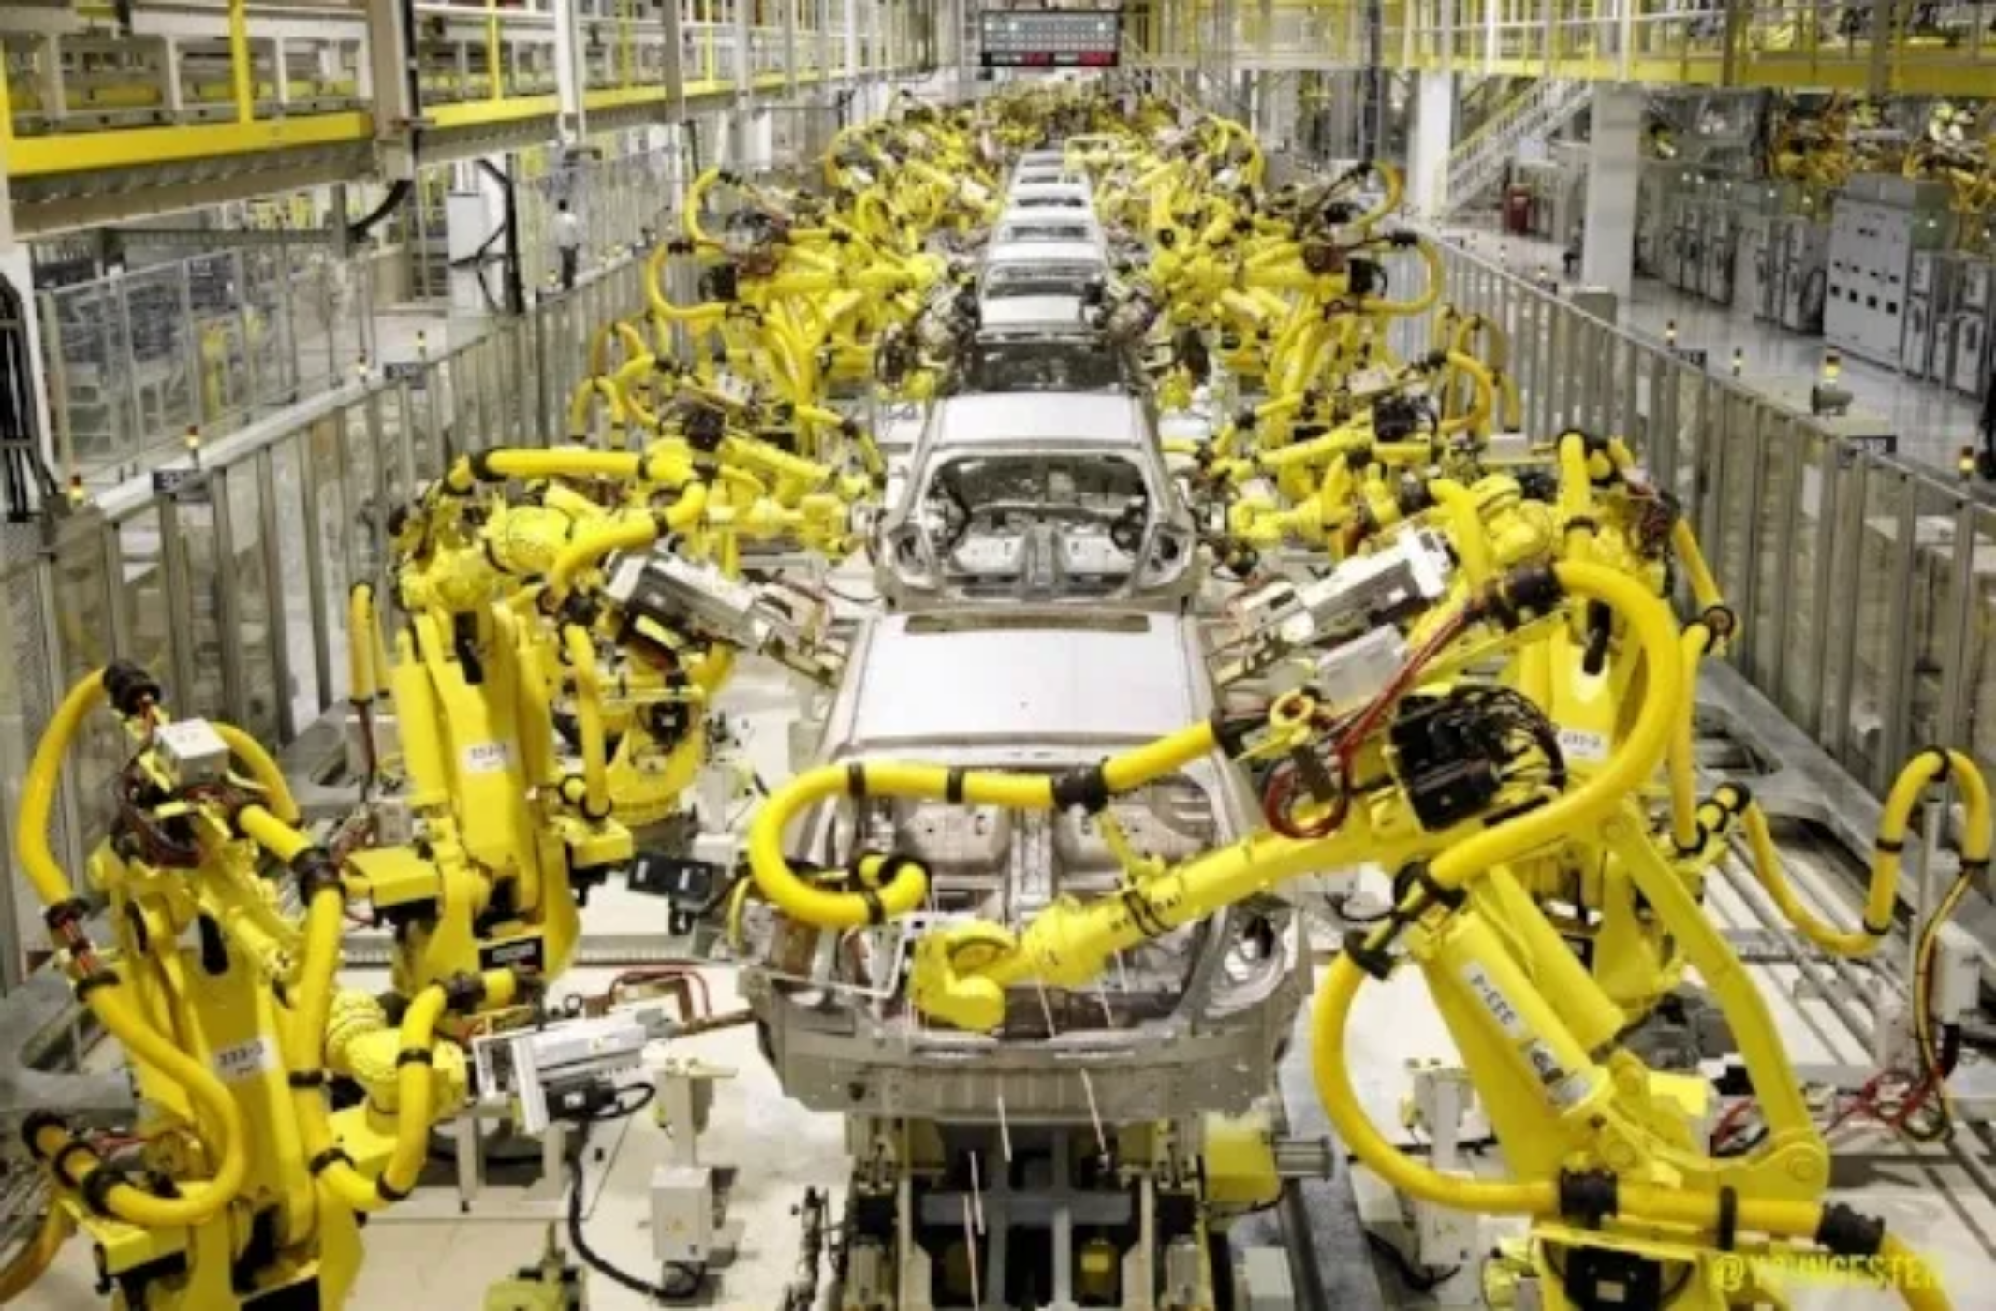



Functional Workcell Creation
System Integrators (SIs) create functional workcells by combining onboarded hardware and skills into agents. Each agent represents a specific component in the robotics system with defined capabilities and interfaces.
Agent Types
Robot Agents
Physical robot hardware with movement capabilities and control interfaces
Sensor Agents
Workcell Creation Process
Data collection devices providing environmental awareness and feedback
1
Open new workcell tab in the React UI
2
Select and configure required agents
Skill Agents
3
Define agent relationships and interactions
Software modules providing specific capabilities like path planning, object recognition, or grasping
4
Save workcell configuration for pipeline creation
Tool Agents
End effectors and specialized equipment for specific tasks

Slide 8
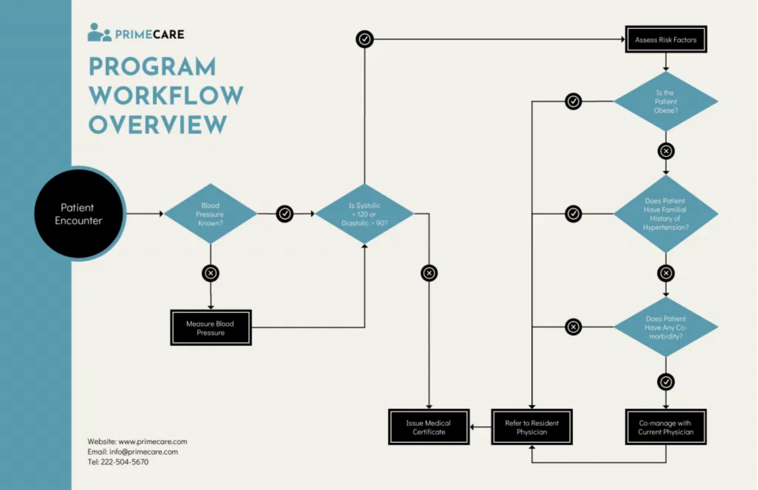





Pipeline Creation & Execution
1
Behavior Tree Arrangement
Skills are arranged into a Behavior Tree (BT) structure defining task sequences, decision points, and error handling strategies.
2
Orchestration Trigger
Task triggers Semaphore Ansible to orchestrate the host machine using repository data, inventory, and configuration parameters.
3
Status Tracking
Orchestration status and pipeline details are stored in PostgreSQL, cached in Redis, and available through the React UI.
4
Pipeline Execution
Behavior Tree
Semaphore
Ansible
PostgreSQL
Redis
System Operator can run the workcell pipeline, monitor execution in real-time, and access logs and metrics.

Slide 9

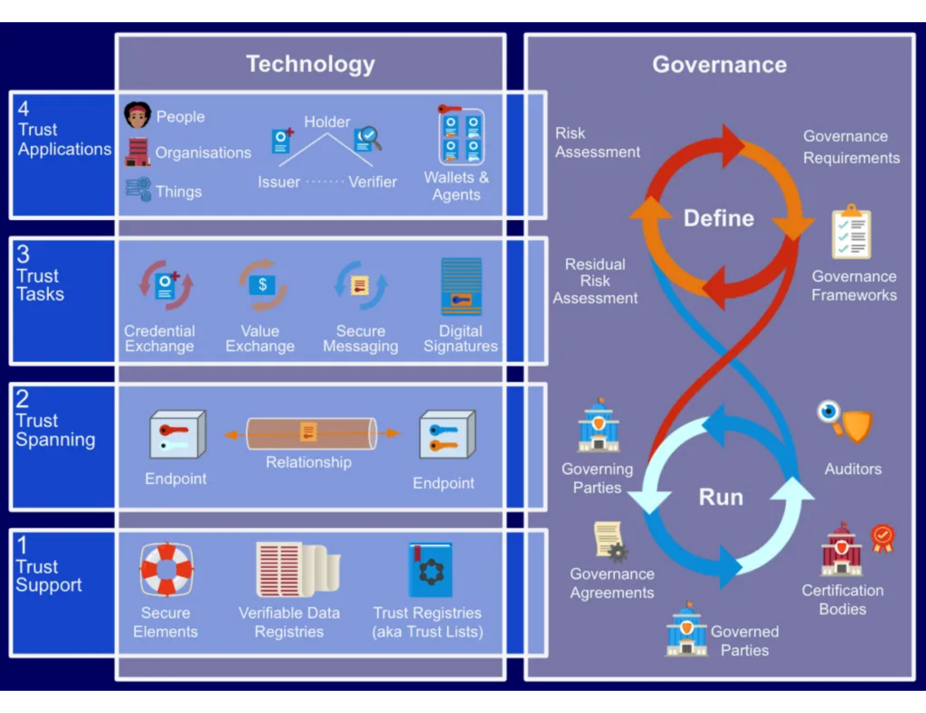

System Workflow Summary
End-to-End Process Flow
1. Component Onboarding
SP
Service Provider pulls hardware/skills from Git repositories and
onboards them to the platform.
2. Workcell Configuration
SI
System Integrator uses the drag & drop interface to build workcells
from onboarded components.
3. Agent Creation
Key System Interactions
SI
System Integrator defines agents (robots, sensors, skills, tools) and
their relationships.
Git repositories provide source components
Semaphore manages CI/CD pipelines
Ansible handles deployment and configuration
PostgreSQL stores persistent data
Redis enables real-time communication
4. Pipeline Definition
SI
System Integrator arranges skills into Behavior Trees for task
execution.
5. Execution & Monitoring
SO
through the React UI.
System Operator runs the pipeline and monitors execution

Slide 10

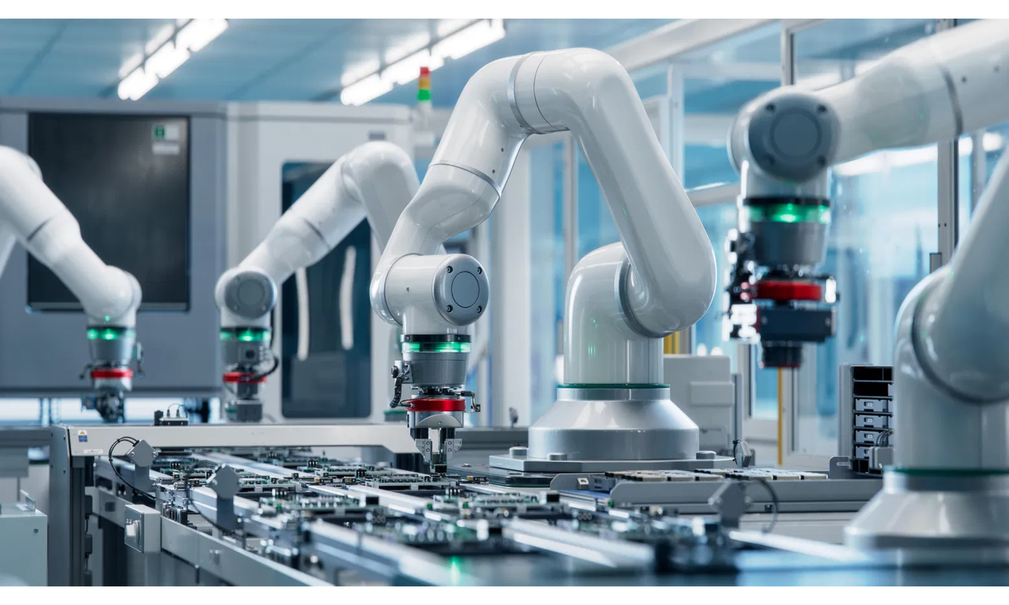








Benefits & Conclusion
Platform Advantages
Standardization & Reusability
Common interfaces and protocols enable component reuse across multiple projects and environments.
Accelerated Development
Drag-and-drop interface and pre-configured components reduce development time by up to 60%.
Modular Architecture
Components can be easily swapped, upgraded, or reconfigured without disrupting the entire system.
Future Possibilities
Reliability & Consistency
Automated orchestration ensures consistent deployment and operation across different environments.
AI-powered skill recommendation and optimization
Cloud-based simulation and testing environment
Community-driven marketplace for specialized components
Advanced analytics and performance optimization

